Slide 1

BLACK FRIDAY SALES PREDICTION
BY
LOKESH K
18BCE1239

Slide 2
About
Black Friday sales dataset
By Retail Stores
550,000 observations
Contains:
Numerical Variables
Categorical Variables
Some missing values

Slide 3
R Packages Used
UsingR
sampling
stringr
tidyverse
stats
prob
dbplyr
Dtplyr
H20
RandomForest
gbm
Caret
Ggplot2
Dummies
rpart

Slide 4
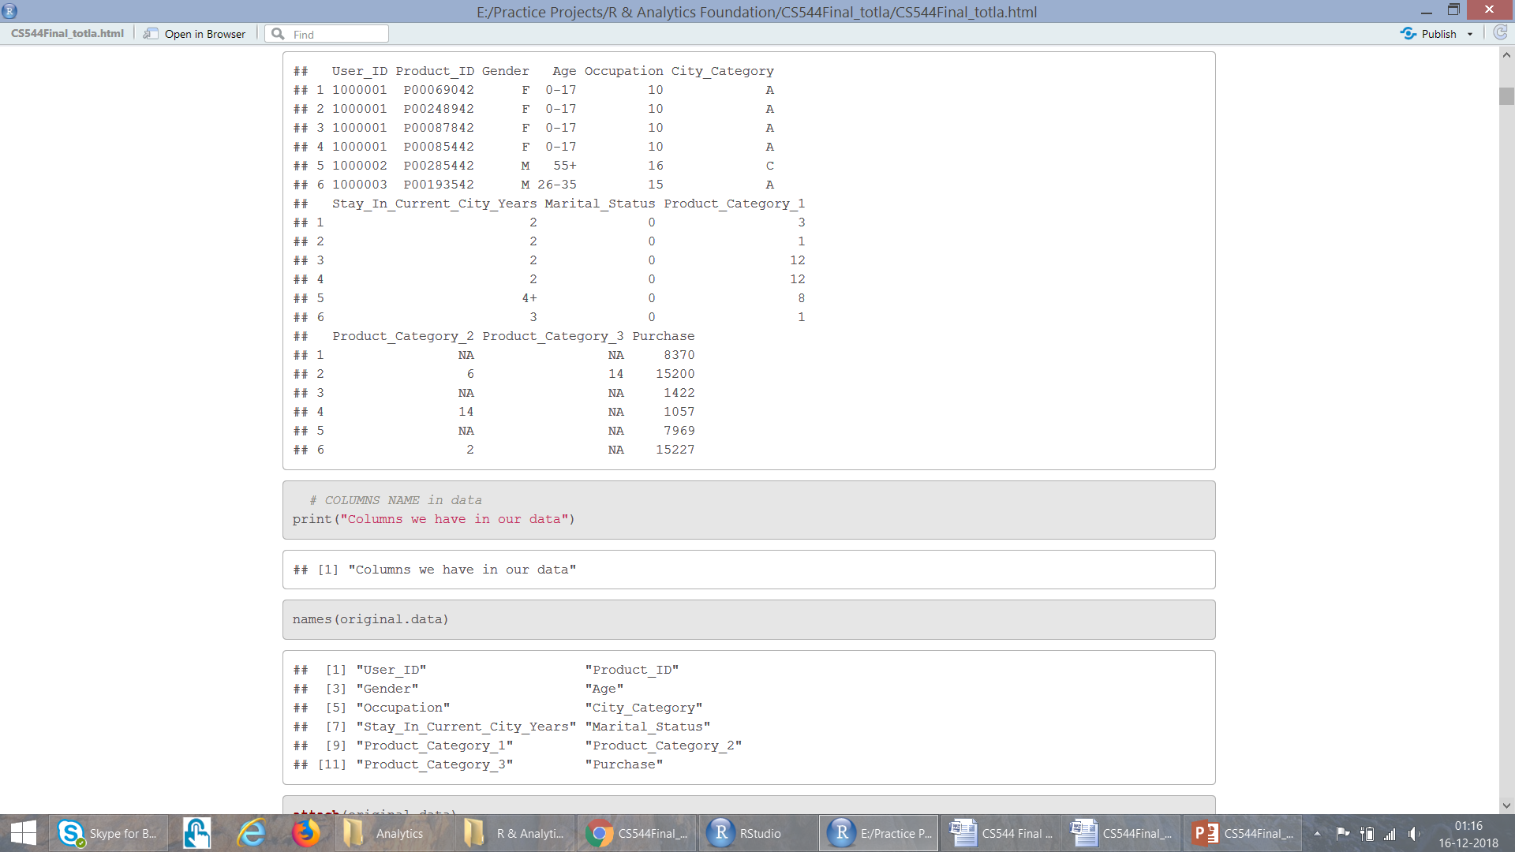
Attributes in Data
User_ID (Numerical Variable)
Product_ID (Categorical Variable)
Gender (Categorical Variable)
Age (Categorical Variable, because it is in ranges)
Occupation (Numerical Variable)
City_Category (Categorical Variable)
Stay_In_Current_City_Years (Numerical Variable)
Marital_Status (Numerical Variable)
Product_Category_1 (Numerical Variable)
Product_Category_2 (Numerical Variable)
Product_Category_3 (Numerical Variable)
Purchase amount in dollars (Numerical Variable)

Slide 5
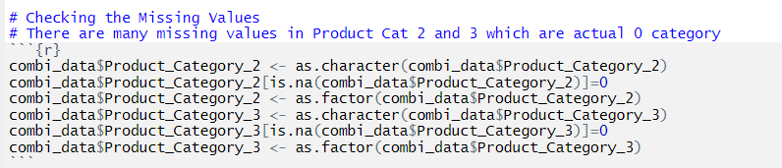
Data Cleaning
We have to convert the NA values into zero before processing.The columns Product category 2 and Product category 3 has NA values which should be converted into zero before using them for analysis and prediction.

Slide 6
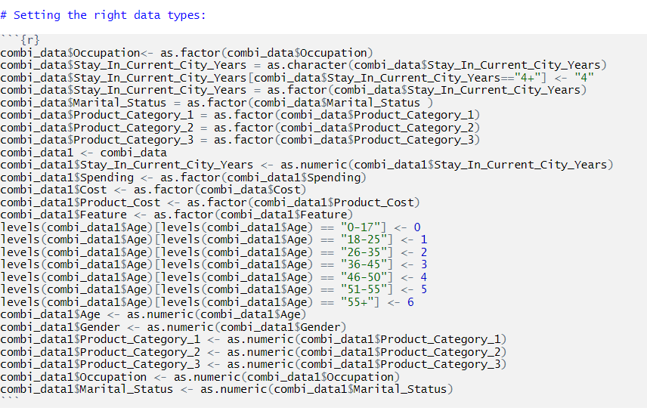
Data Cleaning
The variables must be set to their corresponding data types before processing. Categorical variables are assigned numerical values before using them for regression.

Slide 7
Exploring Attributes
User Id: Not Unique, maps person to the particular purchase
Product Id: Not Unique, tells how many purchases are made for a product
Gender: Have only two variables: F M
Age: It is divided into 7 ranges, Here Age is Categorical Variable
Occupation: There are 21 different occupation ranging from 0-21
City Category: Cities in which customers have lived is categorized into three categories: A, B, C
Year.. : People have lived in the current city for 0-5 years. Here 5 could mean atleast 5 years
Marital Status: People have their marriage status marked as either 0 or 1
Product Category 1: Ranges form 1-18
Product Category 2: Ranges form 2-18
Product Category 3: Ranges form 3-18
Purchase: It is the amount people spent in $ for purchases. Not unique.

Slide 8
Analysis..

Slide 9
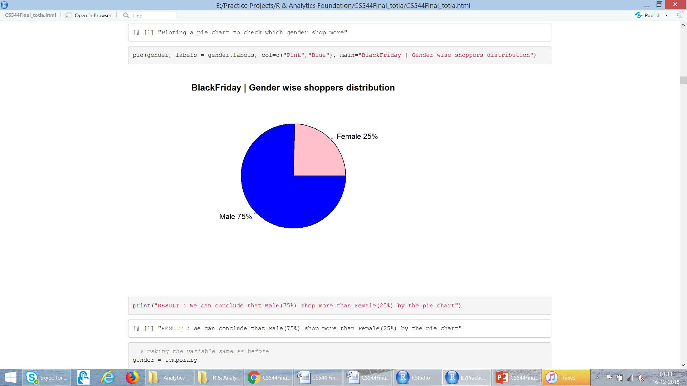
Analyse “Gender”

Slide 10
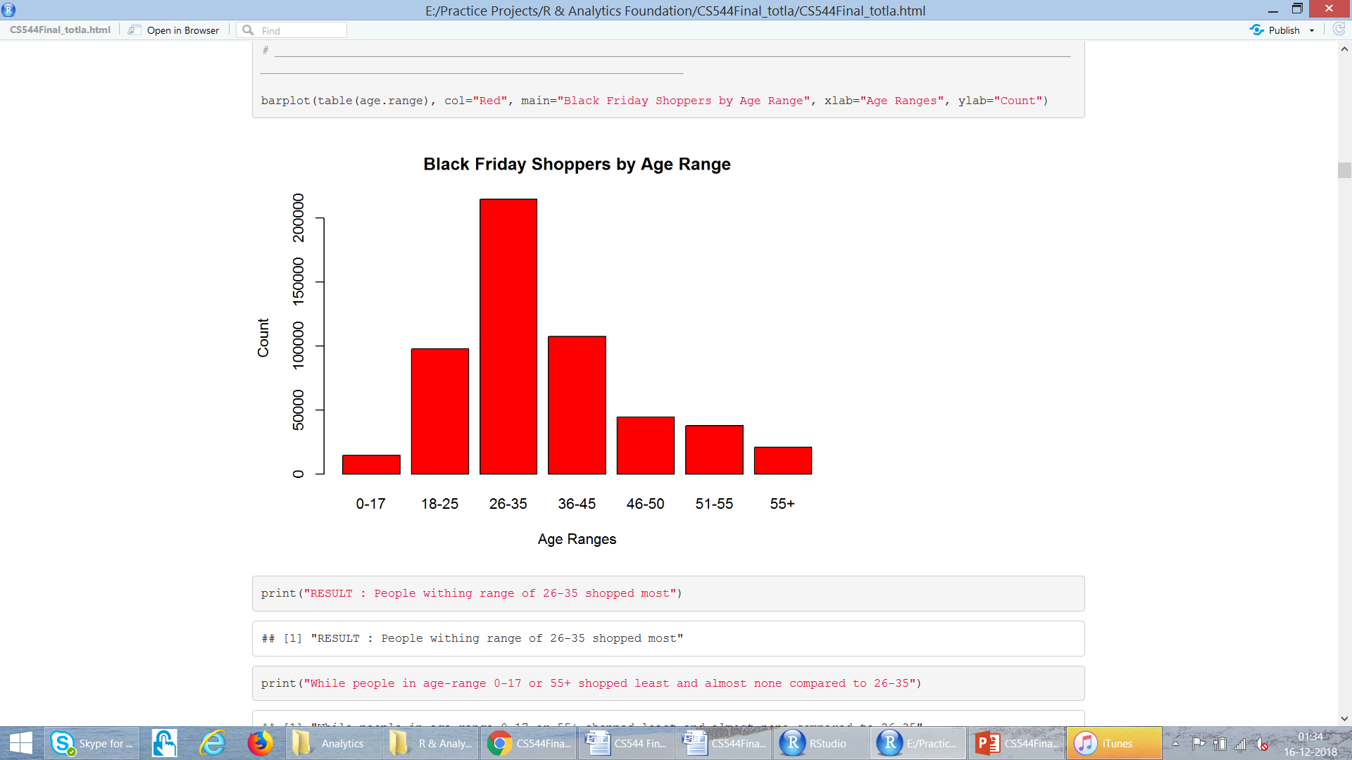
Analyse “Age-Range”

Slide 11
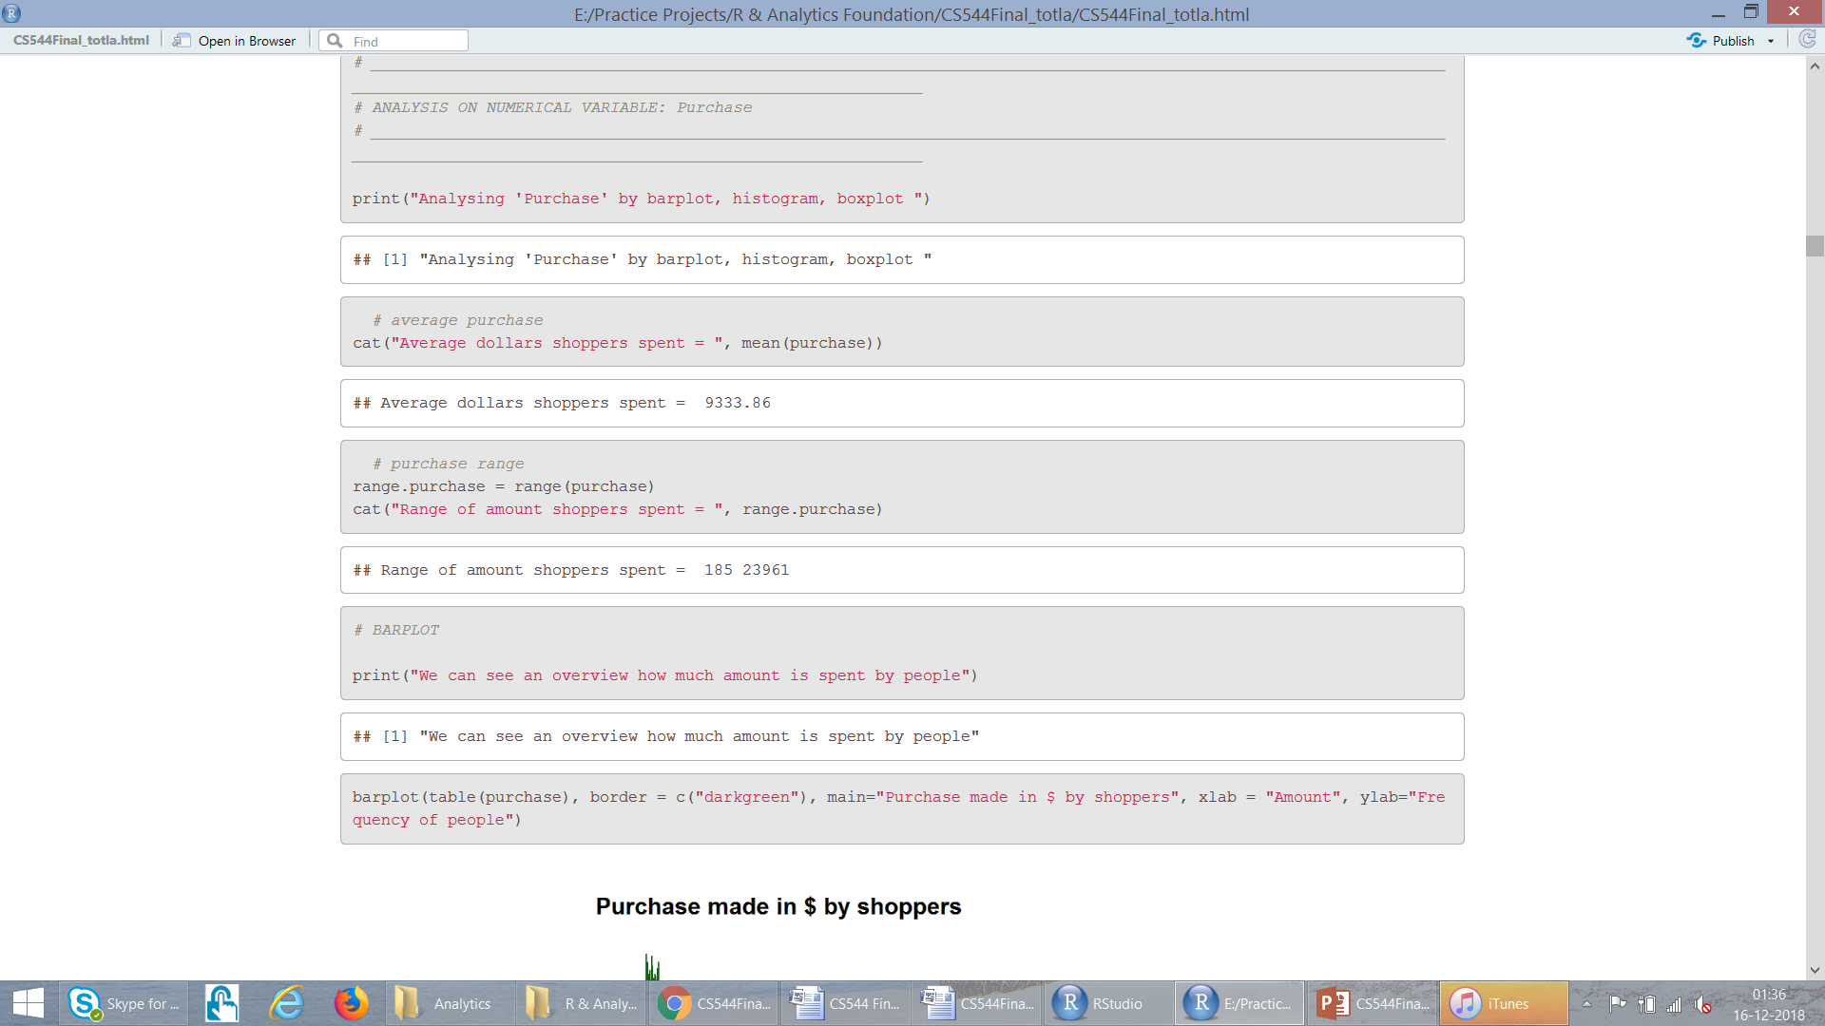
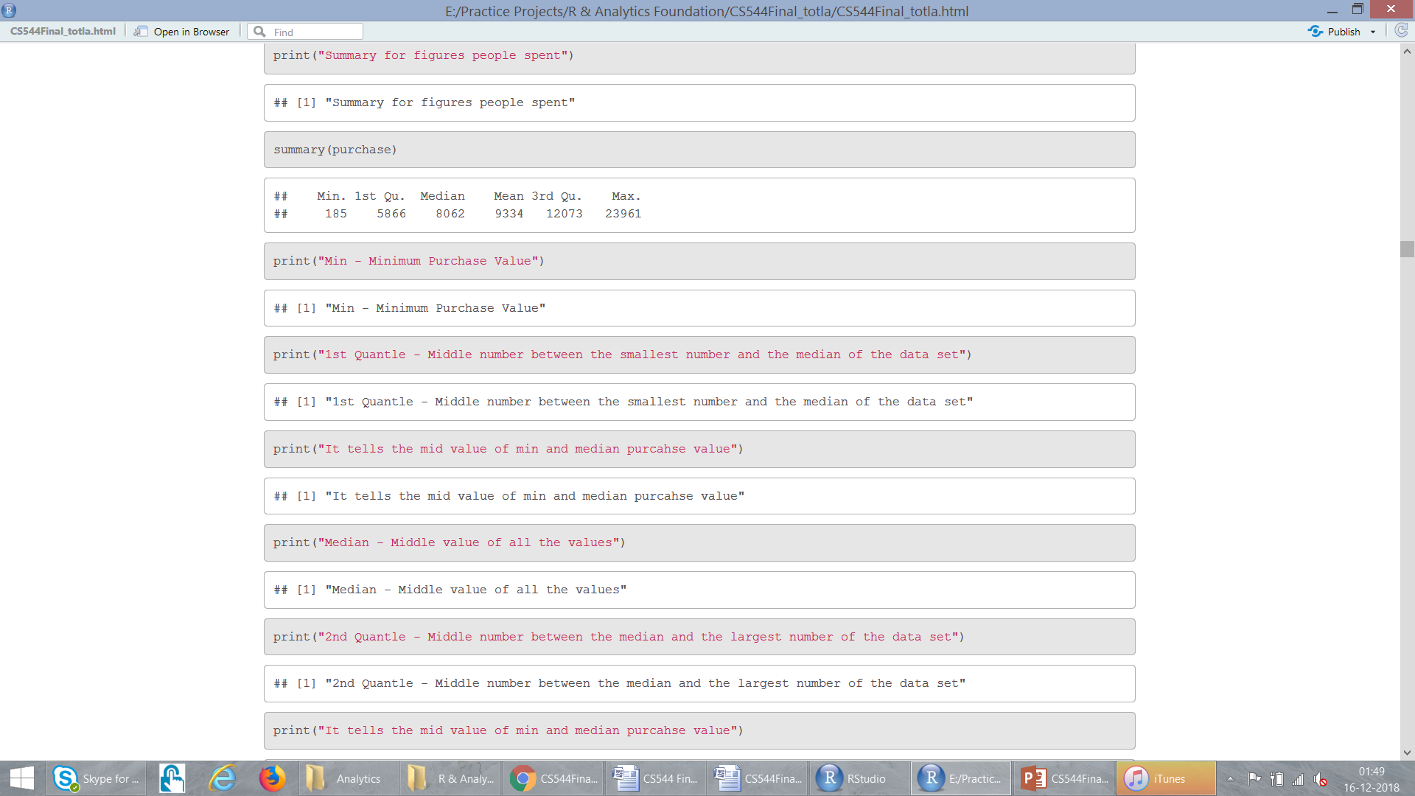
Analyse “Purchase”

Slide 12
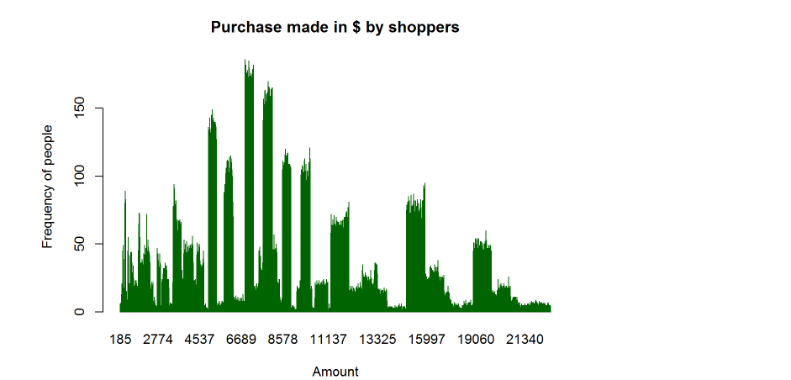
Analyse “Purchase” : Barplot

Slide 13
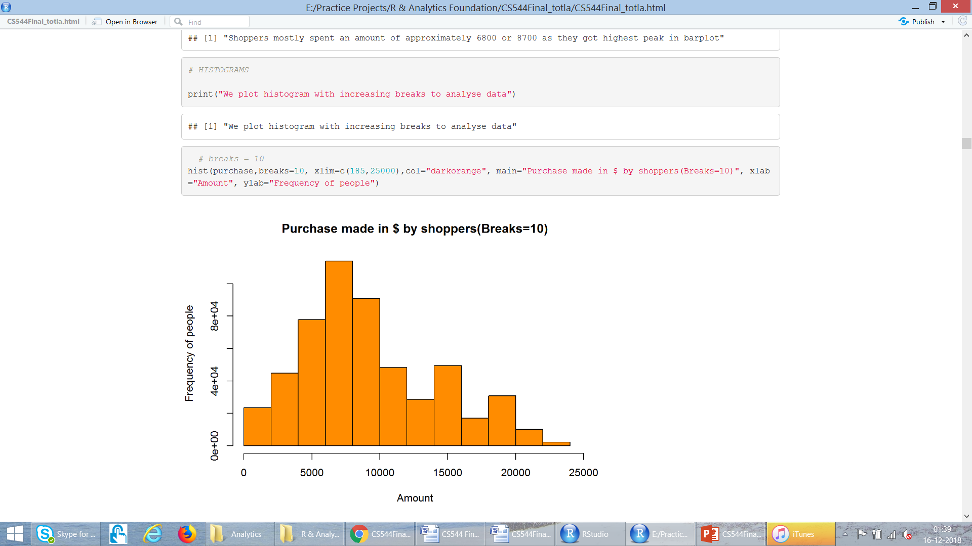
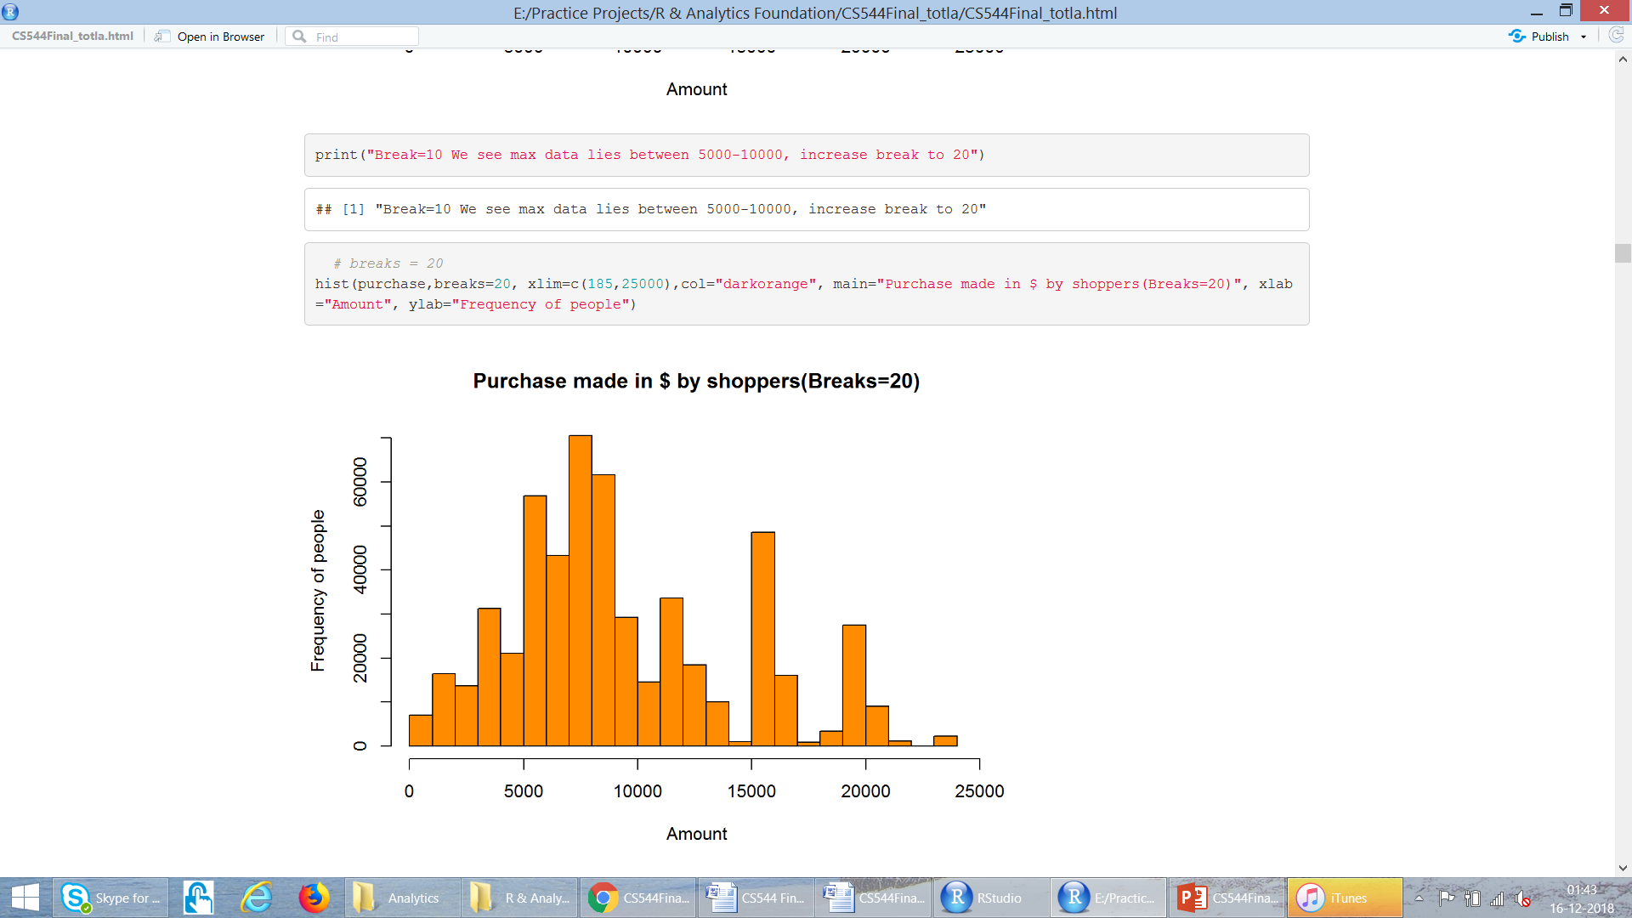
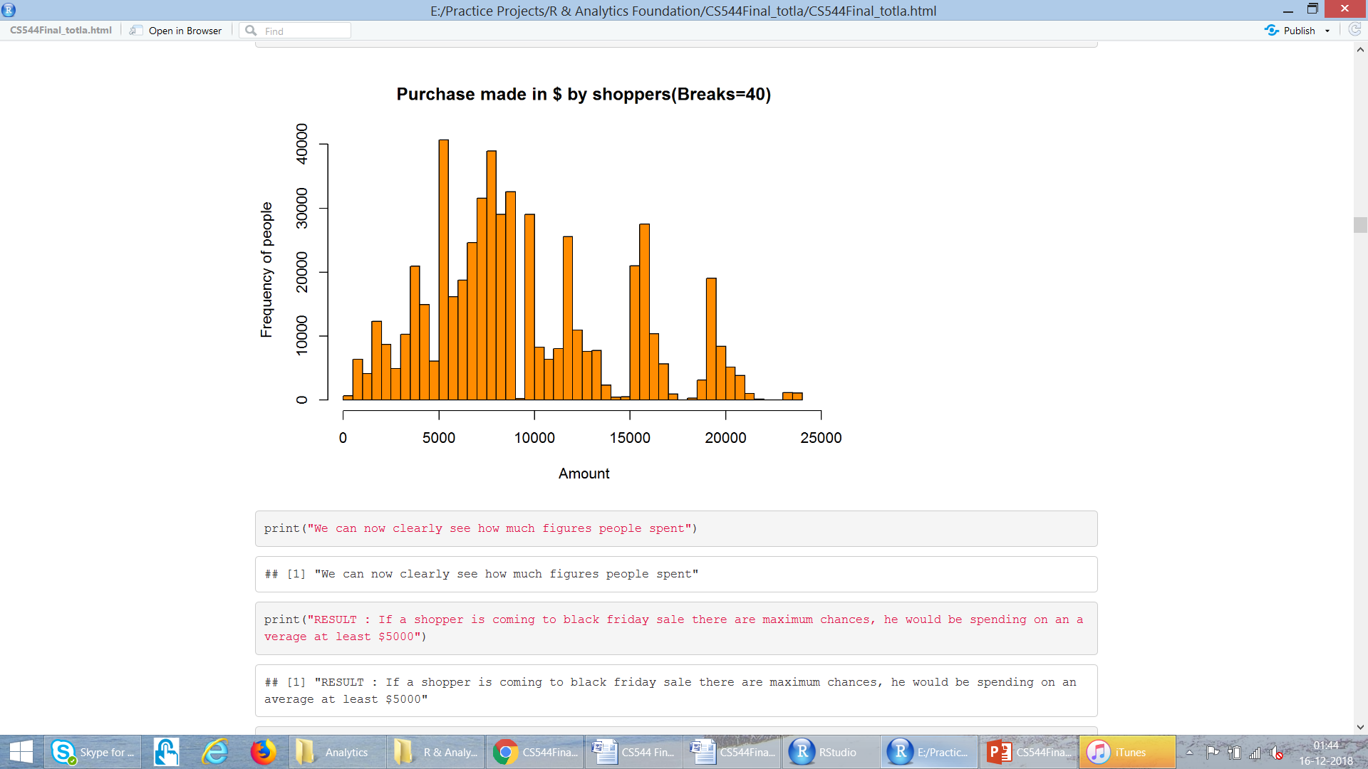
Analyse “Purchase” : Histograms

Slide 14
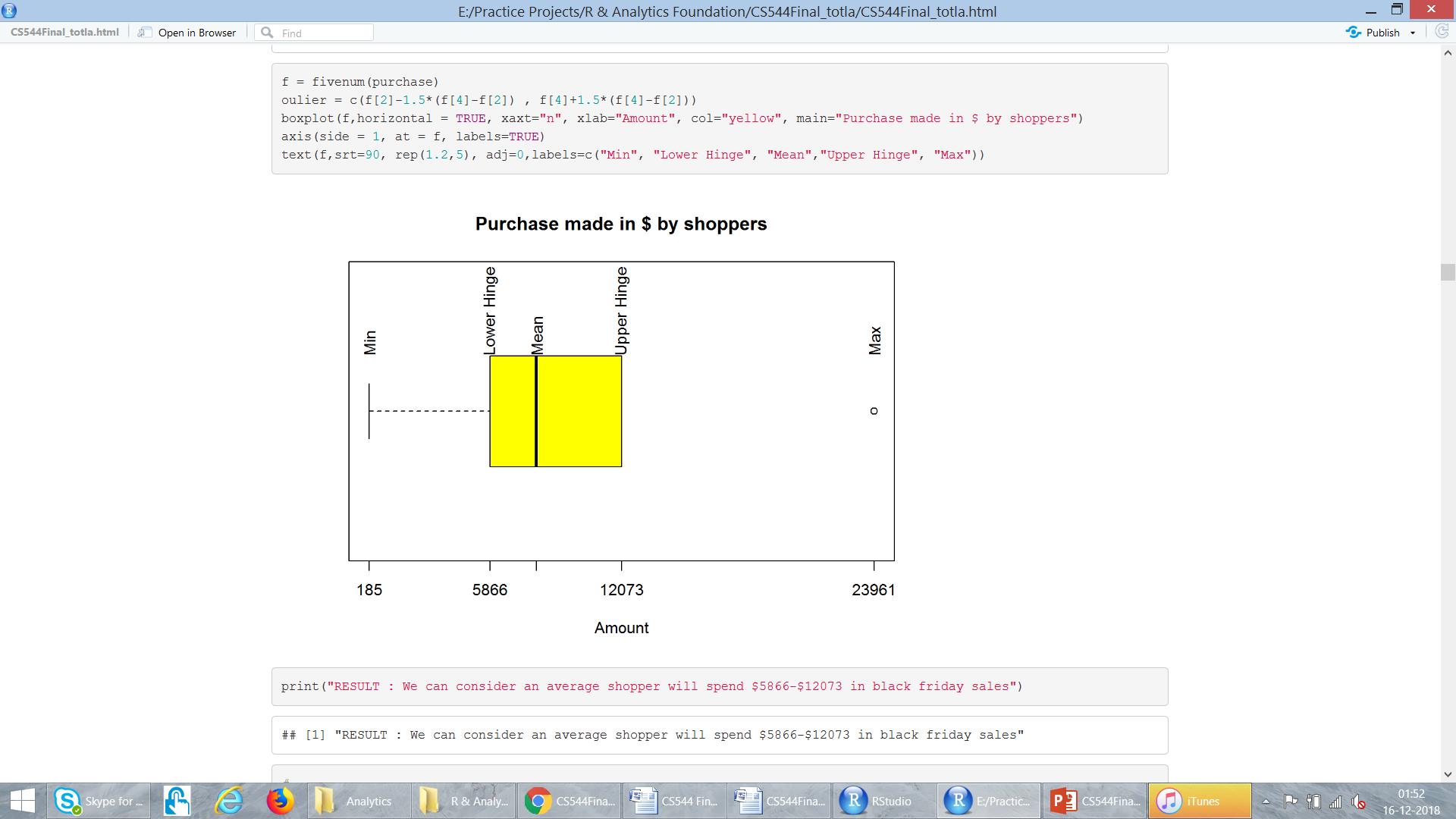
Analyse “Purchase” : Boxplot

Slide 15
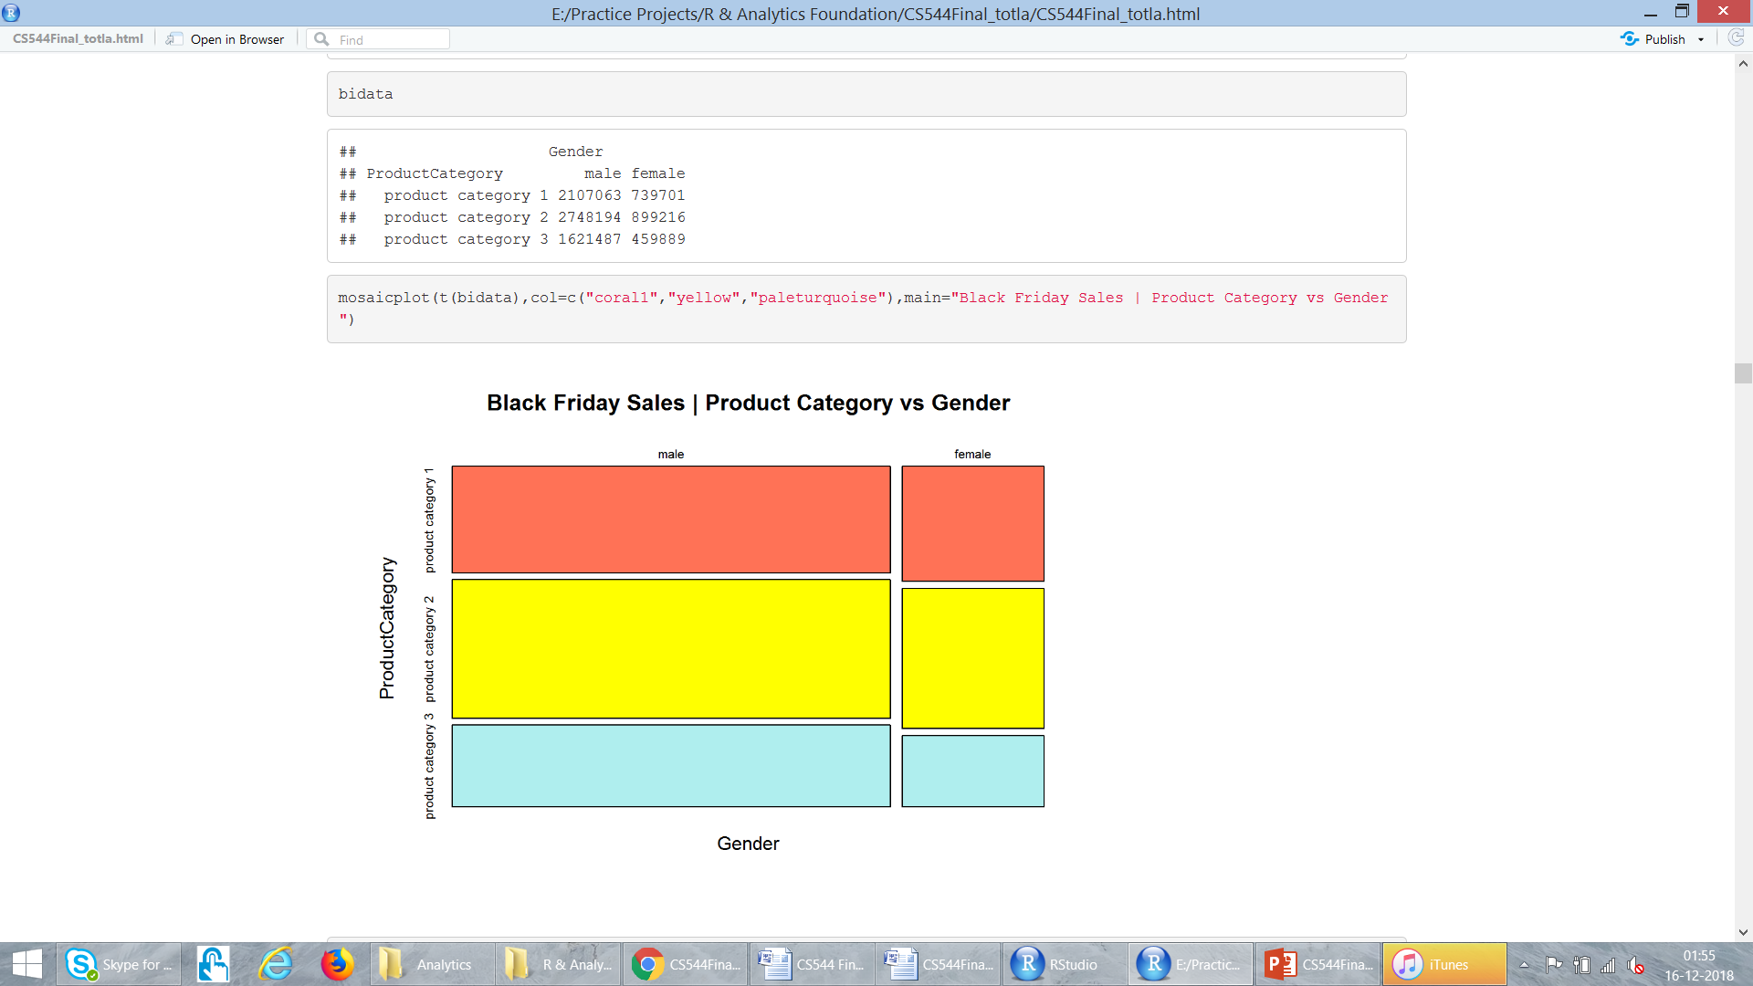
MULTIVARIATE DATA
Gender
Product Category 1
Product Category 2
Product Category 3

Slide 16
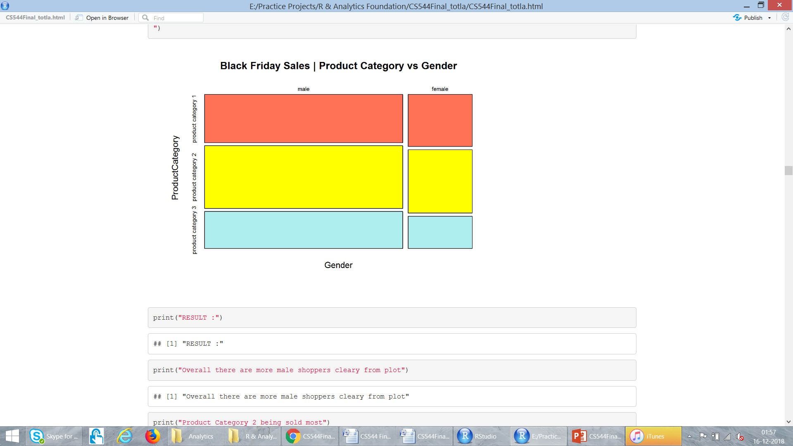
MULTIVARIATE DATA

Slide 17
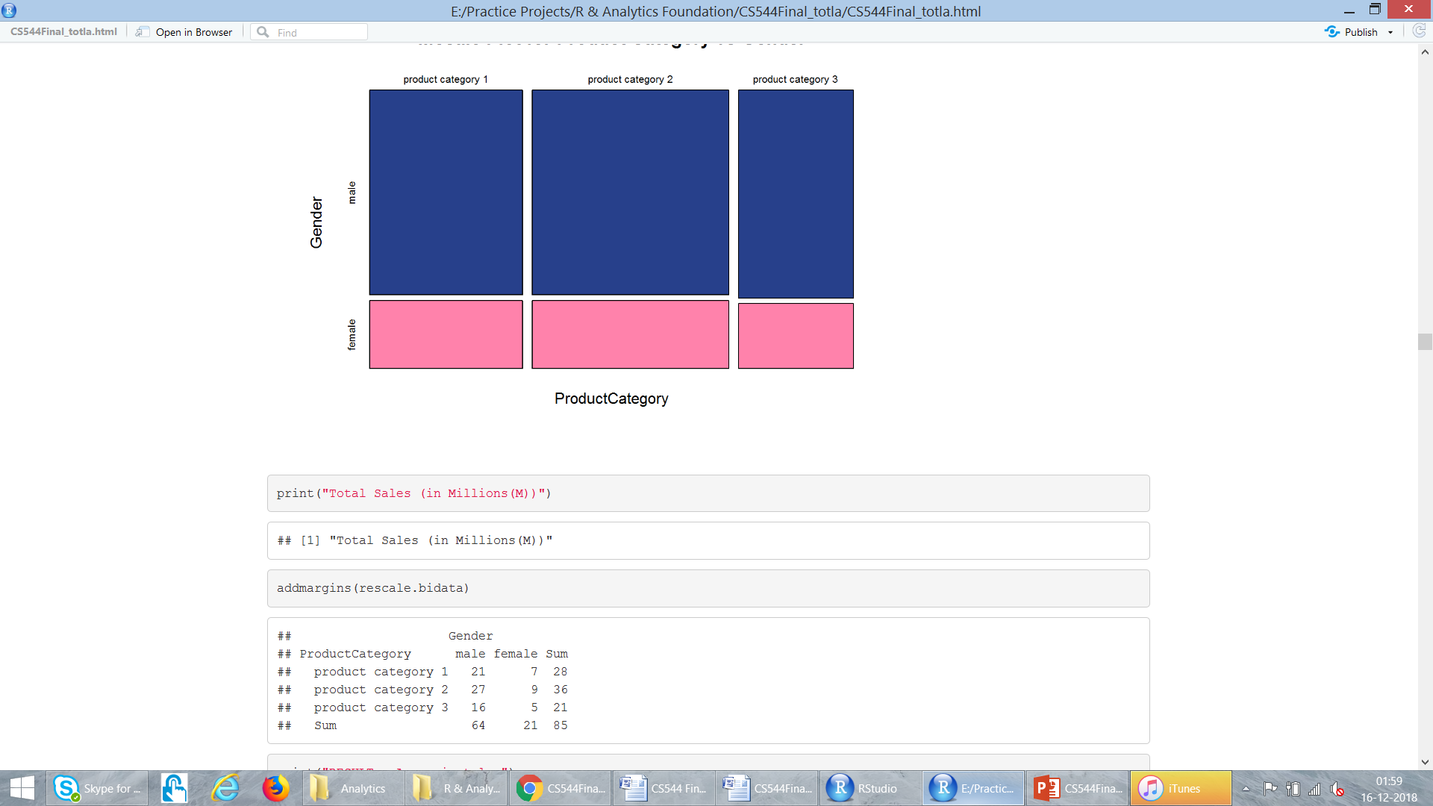
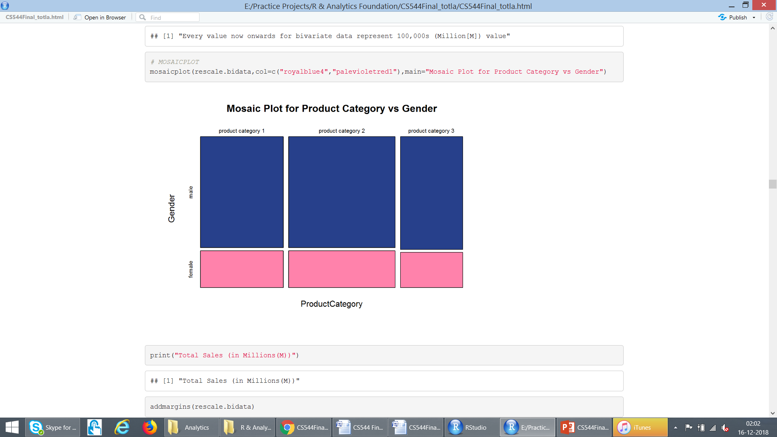
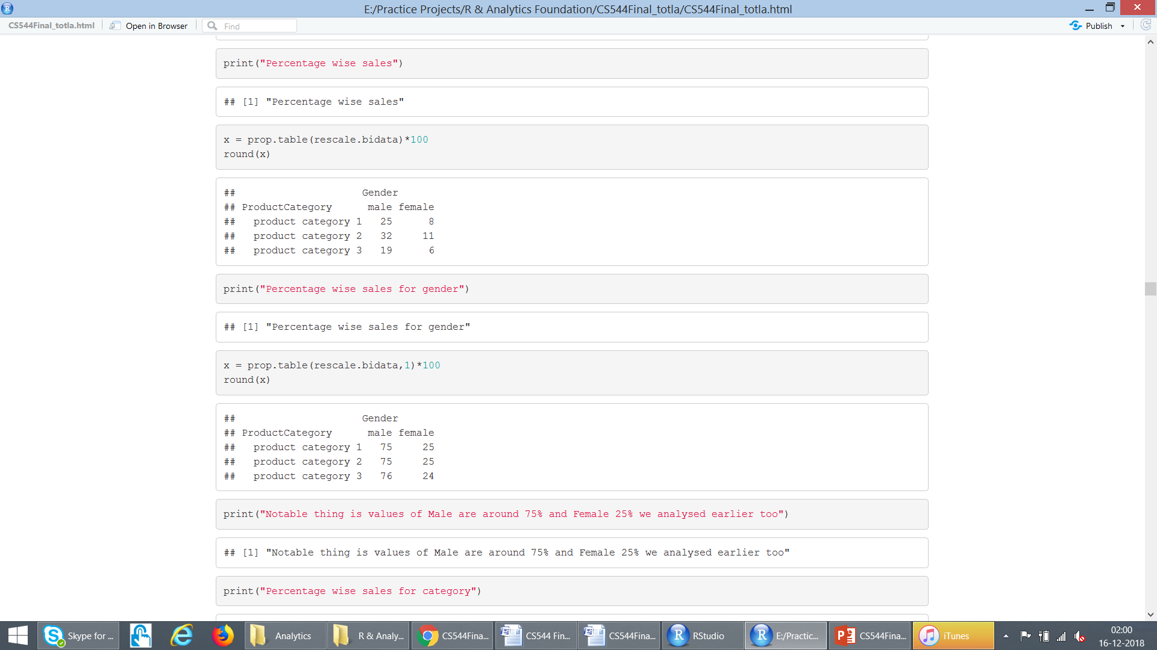
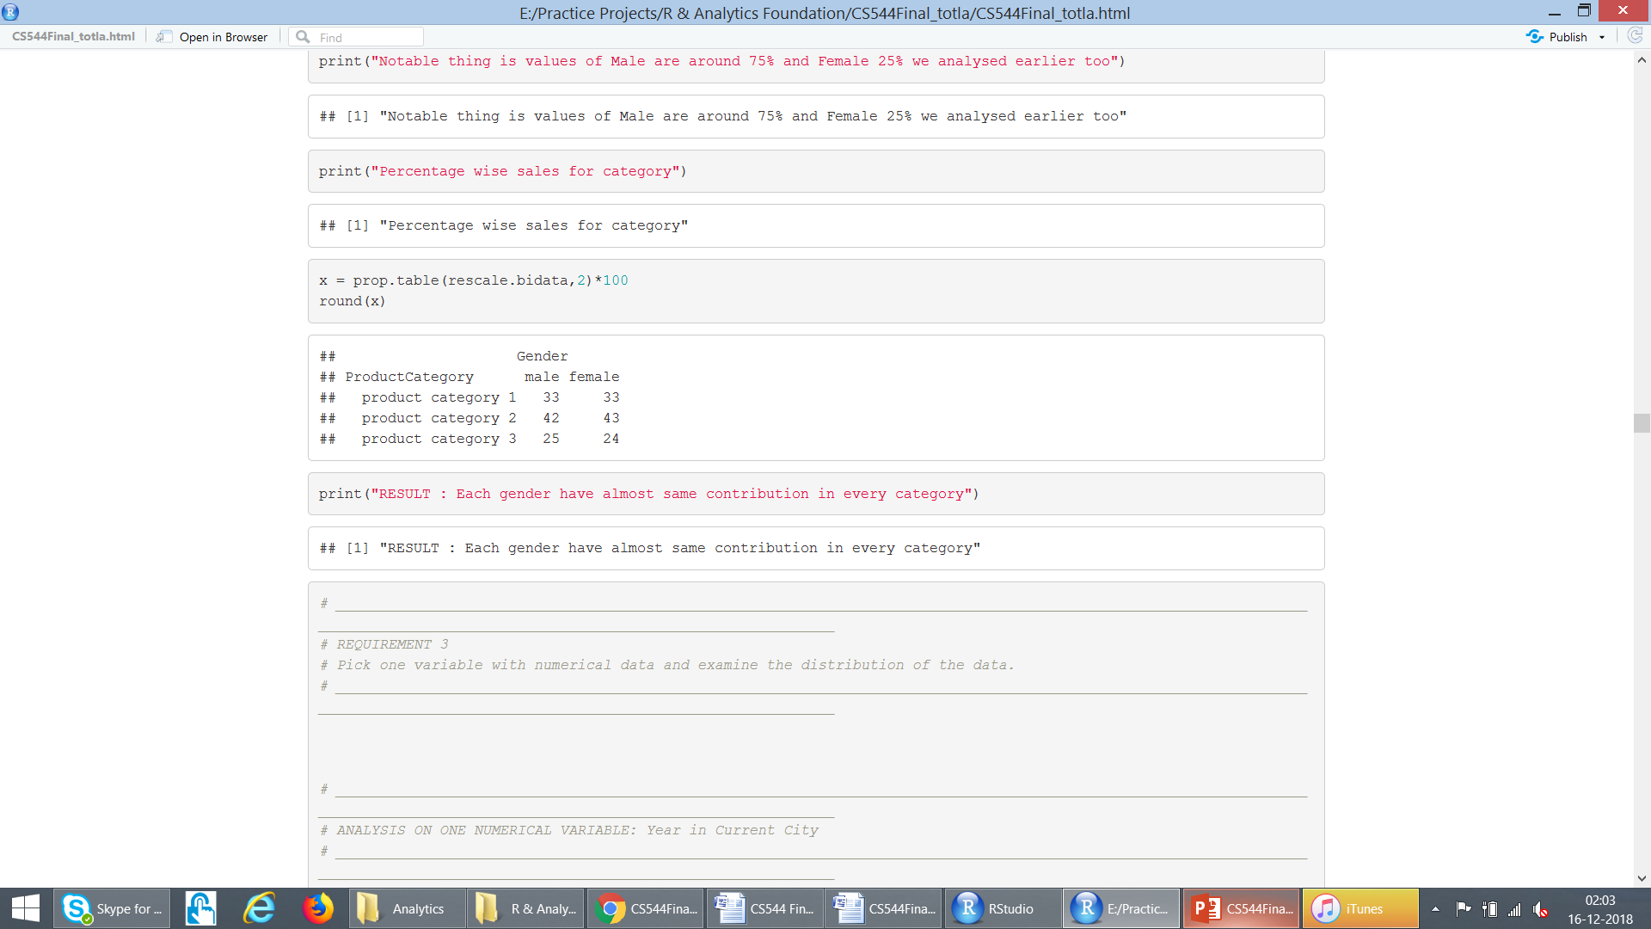
MULTIVARIATE DATA : Rescaled (values in Millions)
Overall
Gender
%tages
Product
Category
%tages

Slide 18
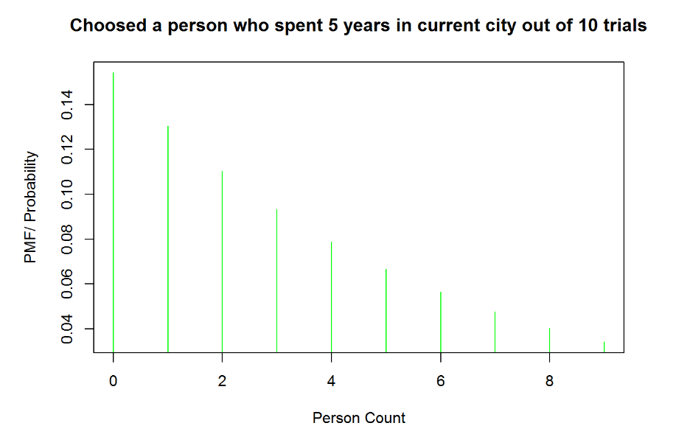
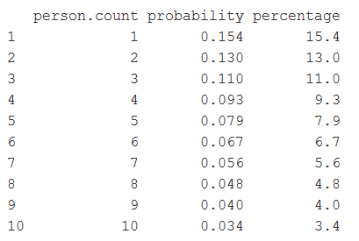
Analyse : “Years in Current City” Geometric Distribution

Slide 19
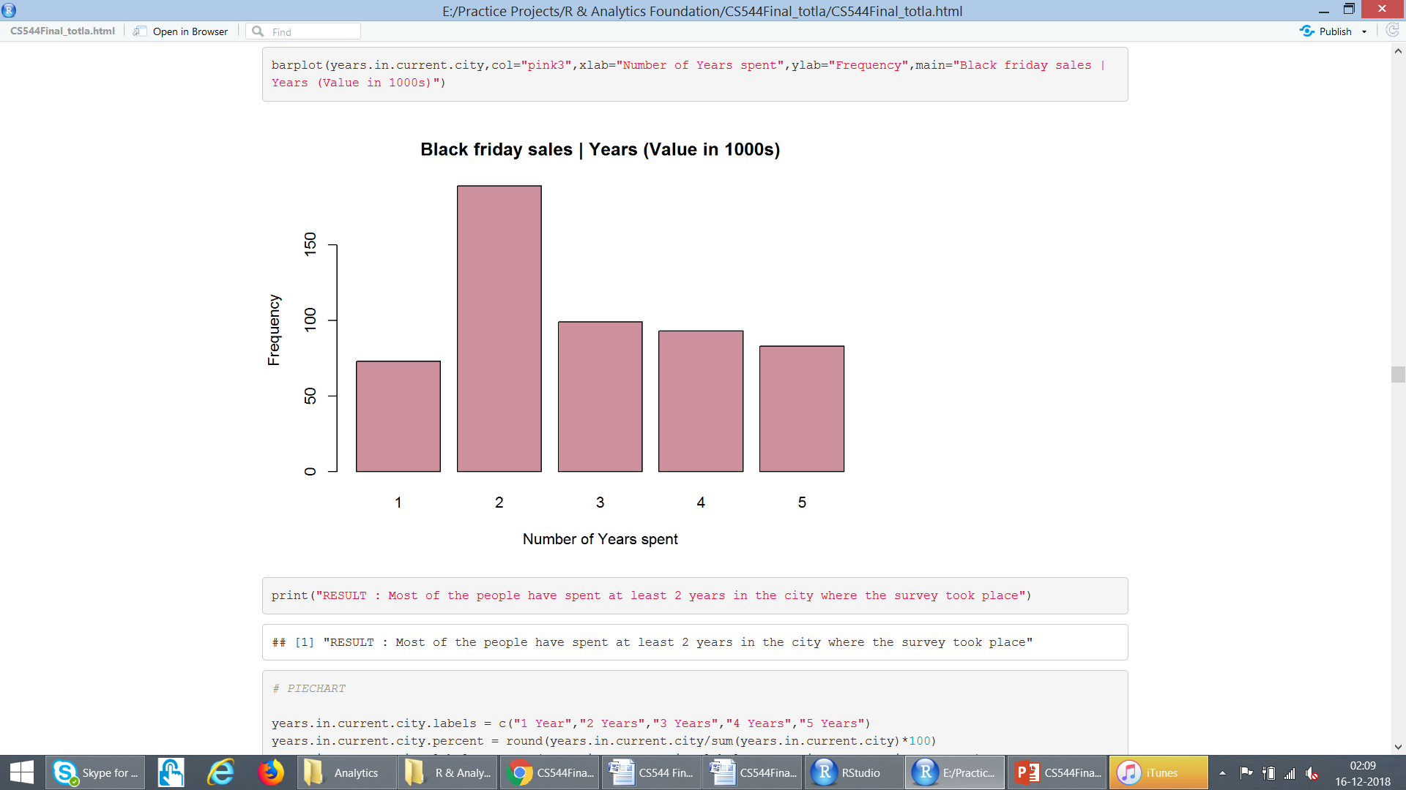
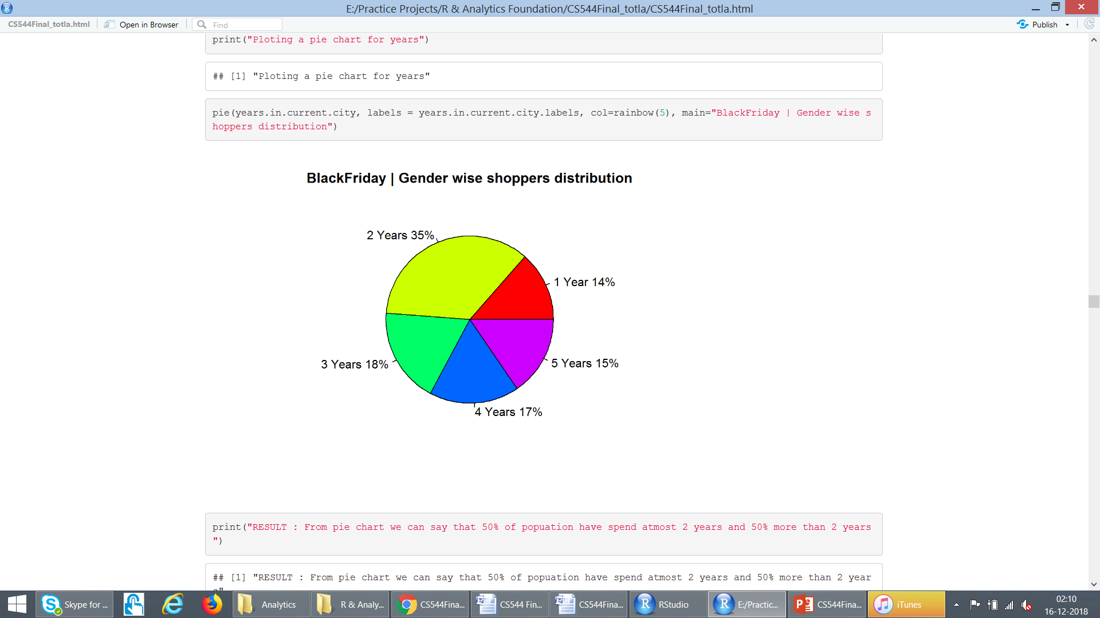
Analyse : “Years in Current City”

Slide 20
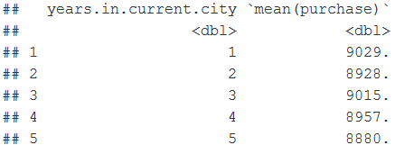
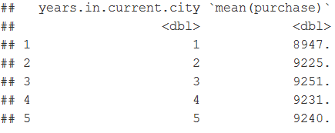
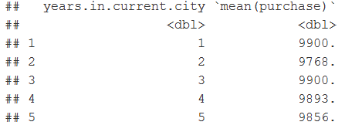
Other Observations (Used String/Tibble)
Average year a person live in following city:
A : 2.81
B : 2.88
C : 2.88
Average purchase in each city as per number of year :
A
B
C

Slide 21
Predictive Analysis
The models used to predict the purchase amount include
Linear regression
Random Forest regression
Gradient Boosting Machines
Deep learning regression
The package I used to build the model and train the data is h2o

Slide 22
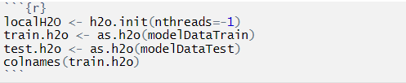
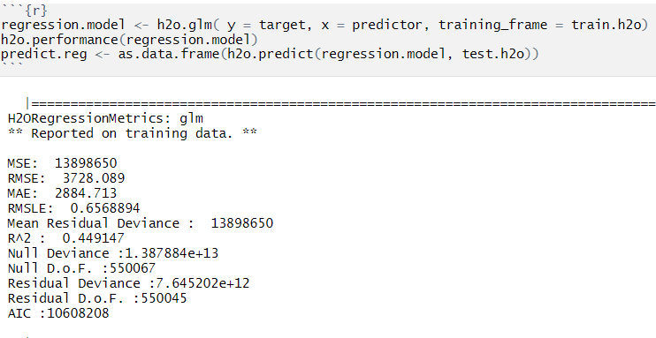
Linear regression
Modelling the data:-
Building the model:-

Slide 23
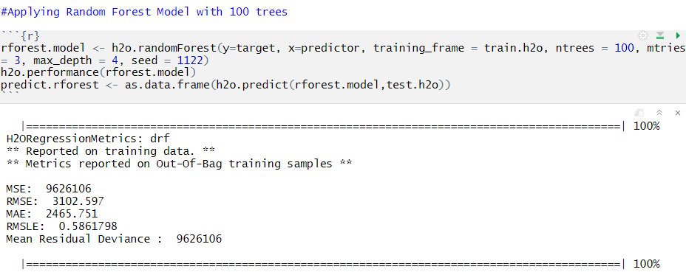
Random Forest regression
Modelling the data:-
Building the model:-

Slide 24
Gradient Boosting Machines
Modelling the data:-
Building the model:-

Slide 25
Conclusion
Number of Male Shoppers > Female Shoppers
Products in Product Category 2 sold most
People generally spent over $5000 in sales
People in age range 26-35 purchase most
There are highest average sales in City Category ‘C’ as compared to other
Unequal Probability sampling technique could be used over this dataset for best results

Slide 26
Thank you!! Questions?

